Slide 1













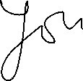












Slide 2








































Slide 3





















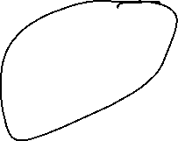




count=-10
while count<=5:
print(count)
count=count+1

Slide 4

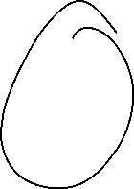















fruits=["apple","banana","cherry","kiwi","guava"]

